Slide 1

Battle of the neighborhoods: Restaurants in Toronto
Ajaykumar Mudaliar

Slide 2
Business Problem
We are looking to open a restaurant in Toronto, the goal is to maximize business profits. The Chef is a keen Indian Chef but is also capable of cooking other cuisines.
Using Data Analysis, we will try to find the answers to the following questions:
When neighborhoods are the best to open an Indian restaurant?
Is opening an Indian the best option in Toronto?
If not, Indian which other cuisines are famous and bound to earn a better profit?
Are Restaurants famous in a concentrated neighborhood or are they distributed?

Slide 3
Approach
We will first retrieve the neighborhoods of Toronto and get the most famous venues in each neighborhood.
Then we filter the venues to just restaurants
We group neighborhoods by unsupervised clustering to check if there is any underlying pattern in the distribution of the restaurants.
We will analyse which are the most famous cuisines in Toronto and where they are located.
We will analyse the distribution of Indian restaurants across Toronto.
We will analyse the number of famous Indian restaurants all around Toronto.
Using this information, we will reach a conclusion on the questions described above.

Slide 4



Data-sources:
Wikipedia to retrieve the postcodes of neighborhoods in Toronto, link = https://en.wikipedia.org/wiki/List_of_postal_codes_of_Canada:_M
Geo-py for latitude and longitude of different postcodes in Toronto.
We will use Foursquare to retrieve reviews and popular venues in Toronto.

Slide 5
Data acquisition and pre-processing
Various methods are used to retrieved and process the data some of them are listed below:
Web scraping using Beautiful soup and filtering on relevant information
Parsing a JSON file to retrieve famous location
One hot encoding of the Categories of venues
Merging two dataframes of information, calculating counts, filtering dataframes and many other formatting techniques

Slide 6
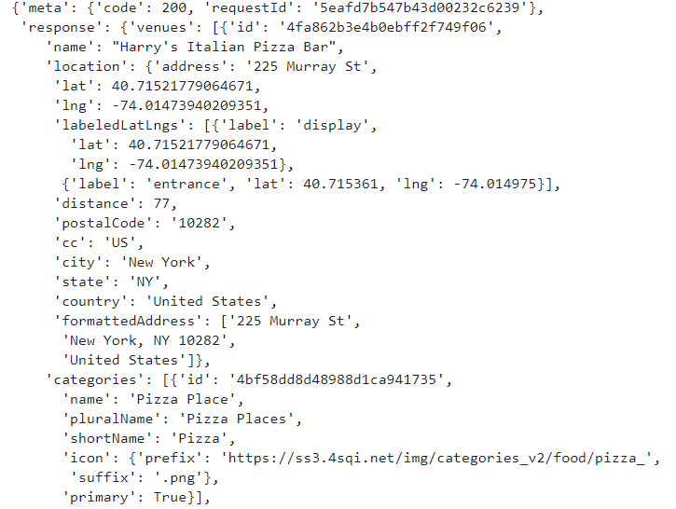
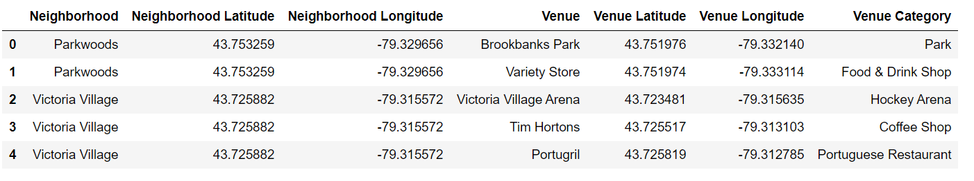
JSON FILE PARSING

Slide 7
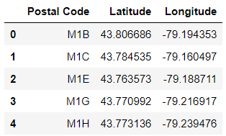
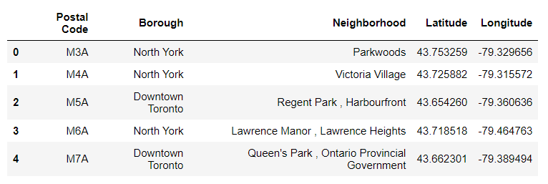
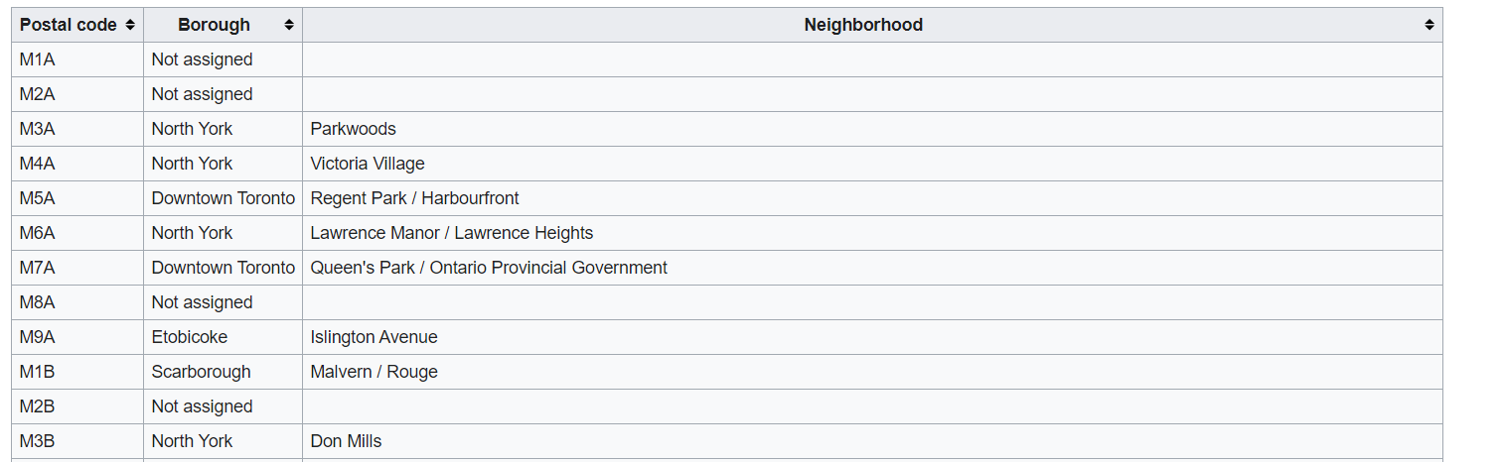
WEB SCRAPING USING BS4

Slide 8
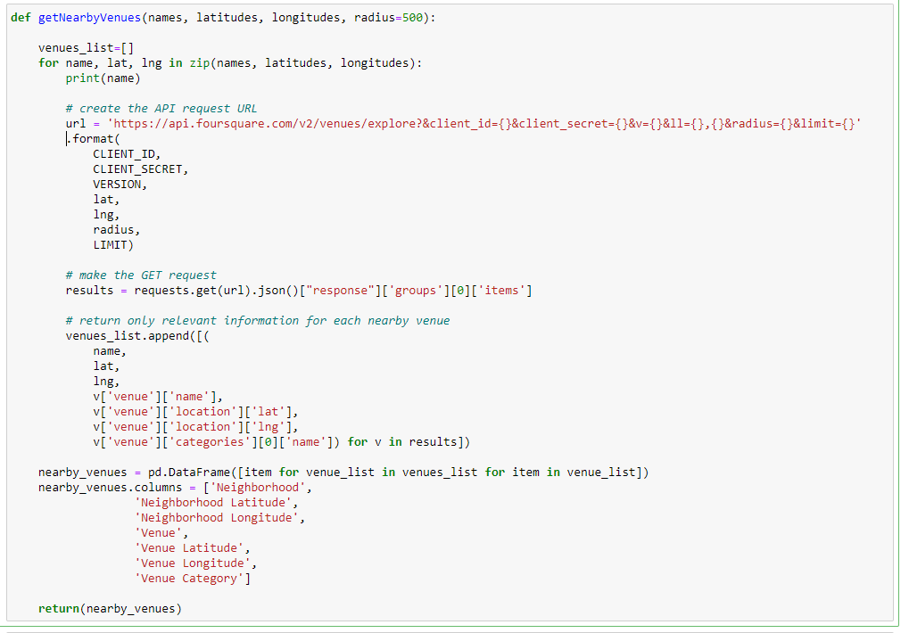
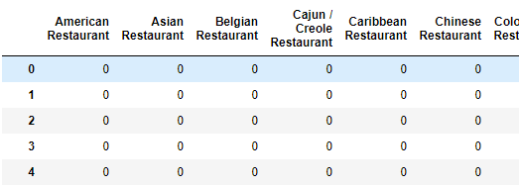
ONE HOT ENCODING

Slide 9
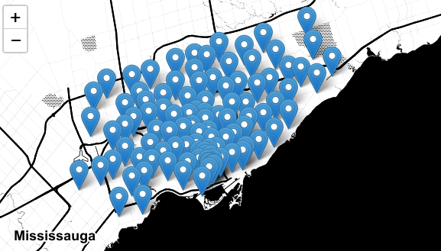
Map of Neighborhoods in Toronto

Slide 10
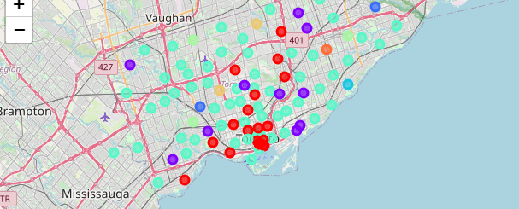
Clustering the data using unsupervised learning: K Means model

Slide 11
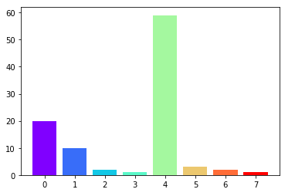
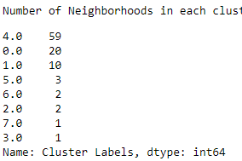
Count of neighborhoods in each cluster

Slide 12
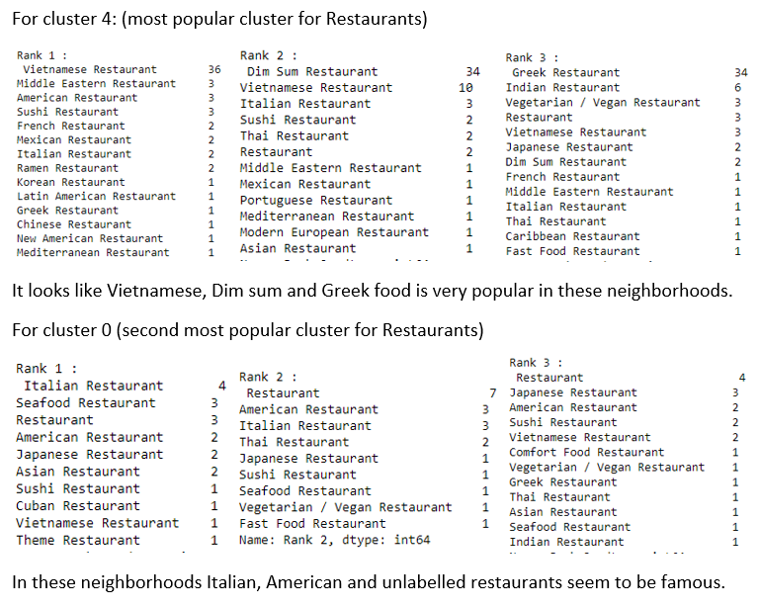
Similarity in famous neighborhoods

Slide 13
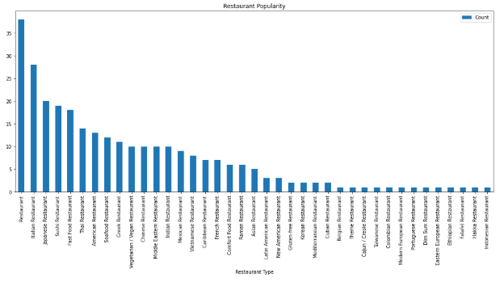
Distribution of famous restaurants according to their cuisines:

Slide 14
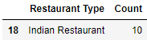
From this we can say that Indian food does not seem to be famous in most of the area having very low number of well-known famous restaurant. Lets future analyse this fact ->
A lot of Unlabeled restaurants, Japanese, Italian, Sushi and fast food chains seem to exist with only 10 popular Indian Restaurants
Looking at the rank (according to number of popular restaurants) of Indian restaurants:
Rank 18/37, Indian restaurant are not so popular in Toronto.

Slide 15
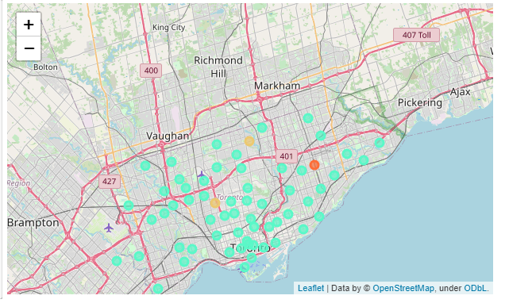
Analysing in which clusters Indian restaurants are famous in:
Most of the famous Indian restaurants lie in cluster 4,6 and 7.
Visualizing this information we see that they are well distributed across Toronto.

Slide 16
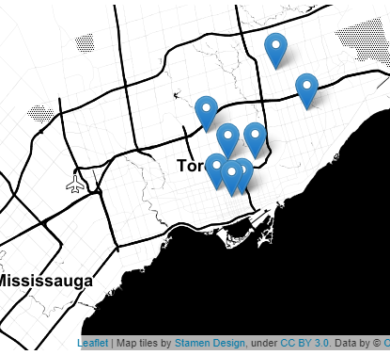
Visualizing exact neighborhoods where the Indian restaurants are famous:
They seem to be around Downtown Toronto, which are commercial area. We can assume their fame is due to the large amount of people in these areas which are business focusced. Business here might be good but also expensive.

Slide 17
Conclusion
The distribution of the cluster containing famous Indian restaurants is un-even, i.e. they are located across Toronto. The specific restaurants lie close to downtown Toronto.
However, they fall at the 18th rank for famous cuisines in Toronto and there are only 10 famous Indian restaurants in Toronto.
Based on this, we can say that the location will not have a big impact on the profits of the new restaurant apart from the fact that a commercial area like downtown Toronto will attract more crowd and is more likely to become famous.
So, we can conclude that if the chef is confident in his ability to impress people with his food, business in crowded areas like near a shopping center will flourish as there are not many well renowned Indian restaurants, however this choice will be risky.
A safer option is to open an Italian or Vietnamese restaurant if the chef can prepare this cuisine as these restaurants are very popular all-around Toronto.

Slide 18
Future work:
After deciding which option, the individual will make, more research on what people prefer in each cuisine will be conducted to refine the menu that will be served in the restaurant. Using the feedback and menus of famous restaurants from Foursquare we can retrieve what are the most liked dishes in the famous restaurant and align our menu to the same.

Slide 19
The END

